Slide 1
Relationships and its Types

Slide 2

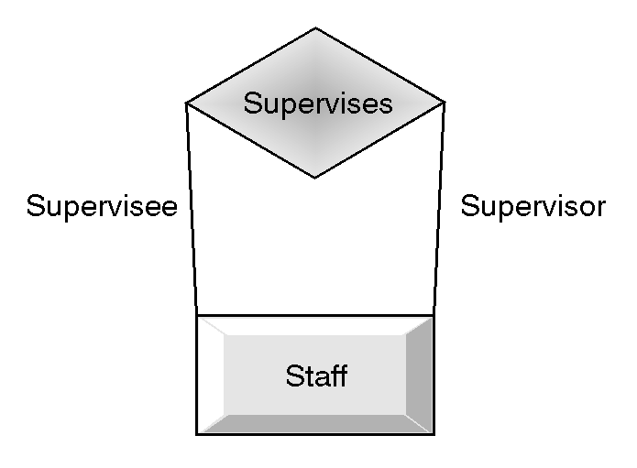
A relation having one entity set is called unary
relation or recursive relation.
Ex:

Slide 3

A relation having two entity sets is called
binary relation.
Ex:

Slide 4
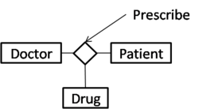
A relation having three entity sets is called ternary relation.
Ex:
Similarly, a relation having n entities is called n-ary relation.
The number of entities in a relation gives the degree of a relation.

Slide 5
Mapping Cardinalities:
It expresses the no. of entities to which another entity can be associated via a relationship set.
For a binary relationship R between the entity sets A and B, the
mapping cardinalities must be one of the following:-
One –to-one:- An entity in A is associated with at most one entity in B and vice-versa.
ex: One manager manages one department.
One- to many:- An entity in A is associated with any no. of entities in B. However an entity in B can be associated with at most one entity in A.
Ex: One Teacher teaches many Students.

Slide 6
Many-to-one:- An entity in A is associated with at most
one entity in B. An entity in B can however be associated
with any no. of entities in A.
Ex: Many goods are produced by one company.
d) Many –to- many:- An entity in A is associated with any
no. of entities in B. An entity in B is associated with any
no. of entities in A.
Ex: Many engineers works for many projects.

Slide 7
Participation Constraints:
The participation of an entity set E in a relationship set R is said to be total , if every entity in E participates in at least one relationship in R.
Example: all employees of a department work in that department.
If only some entities in entity set E participate in relationship R, the participation is said to be partial.
Example: A manager(an employee) manages the department.

